Slide 1
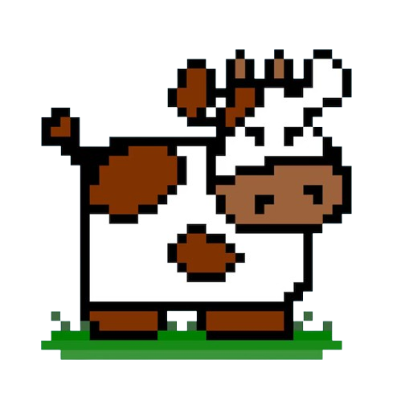

COWS AND BULLS!
A Number Guessing Game of entropy and mutual Information
Nikhitha Nagalla
Mathematical Foundations of Data Science
12/01/2024

Slide 2
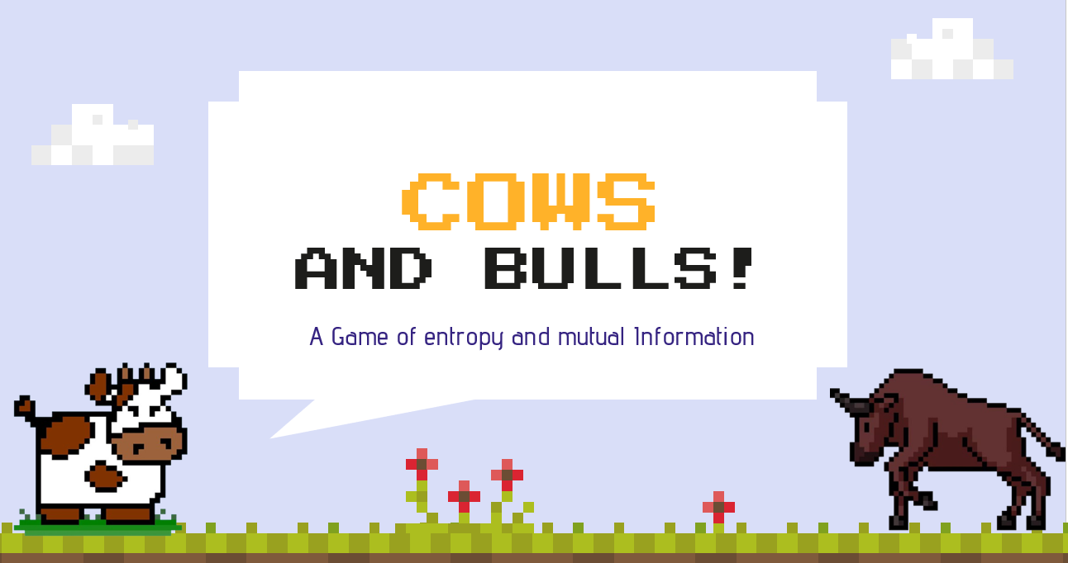
Who can play?
Human
To guess the secret number generated by another player
Computer
Generates the secret number and validates the guesses

Slide 3
INTRODUCTION!
This project focuses on a simple number-guessing game.
In this game, there will be two players who play and 2 important characters that include
Cows – correct digits in the wrong position
Bulls - correct digits in the correct position
The objective of the player is to guess the secret number by clues (cows and bulls) after each attempt
Mathematically, Entropy and Mutual Information play an important role in guessing the correct secret code.

Slide 4



HOW TO PLAY?
START GAME
Computer generates a secret game
CONTINUE GUESSING
Continue guessing the number reducing the entropy.
MAKE GUESS
The player guesses the number, and the cows and bulls are determined.
END GAME
If the number is correctly guessed, the player wins.
PROVIDE FEEDBACK
Based on cows and bulls, entropy and mutual information can be calculated.

Slide 5
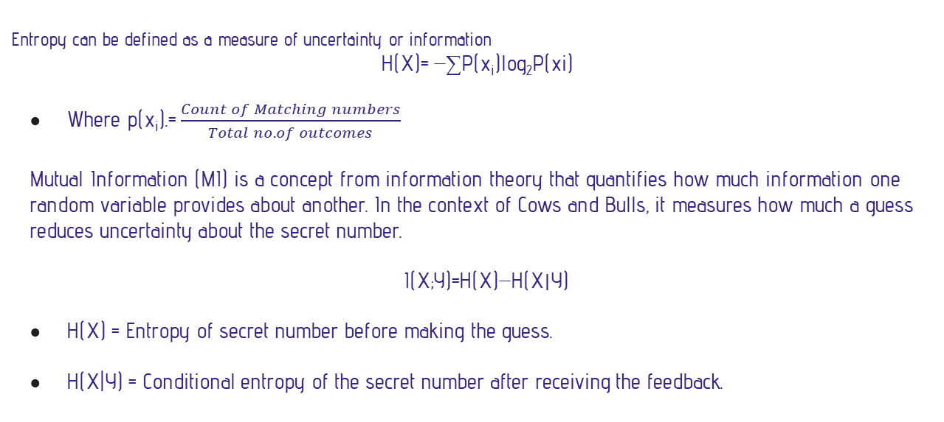
ENTROPY & MUTUAL INFORMATION
Entropy can be defined as a measure of uncertainty or information
H(X)= −∑P(x_{i​})log₂​P(xi​)
Where p(x_{i}).= $\frac{Count of Matching numbers}{Total no.of outcomes}$
Mutual Information (MI) is a concept from information theory that quantifies how much information one random variable provides about another. In the context of Cows and Bulls, it measures how much a guess reduces uncertainty about the secret number.
I(X;Y)=H(X)−H(X∣Y)
H(X) = Entropy of secret number before making the guess.
H(X|Y) = Conditional entropy of the secret number after receiving the feedback.

Slide 6

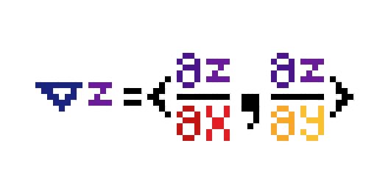
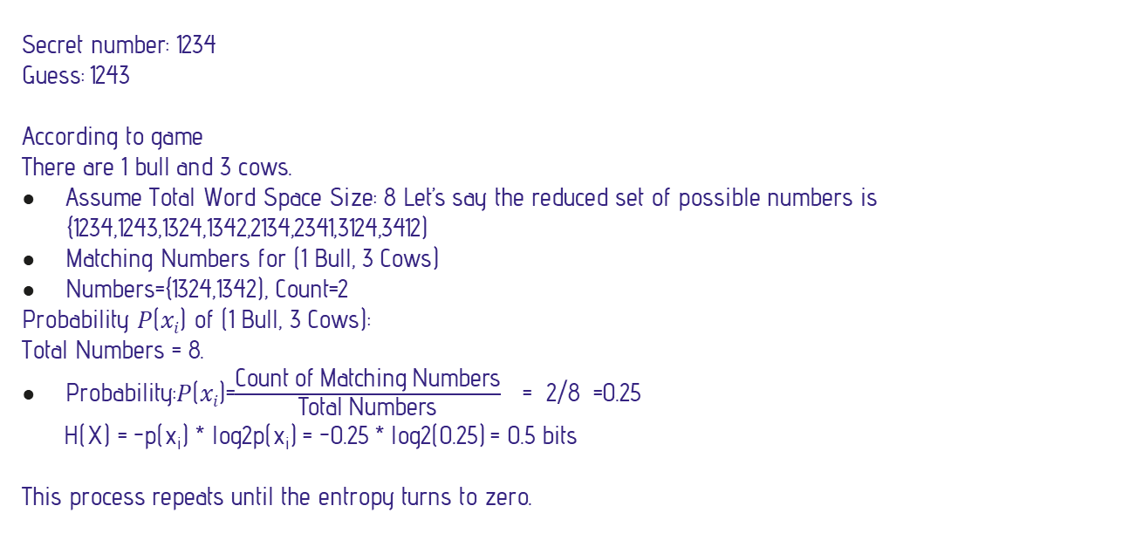
EXAMPLE - ENTROPY
Secret number: 1234
Guess: 1243
According to game There are 1 bull and 3 cows.
Assume Total Word Space Size: 8 Let’s say the reduced set of possible numbers is {1234,1243,1324,1342,2134,2341,3124,3412)
Matching Numbers for (1 Bull, 3 Cows)
Numbers={1324,1342), Count=2
Probability 𝑃(𝑥_{𝑖}) of (1 Bull, 3 Cows):
Total Numbers = 8.
Probability:𝑃(𝑥_{𝑖})=$\frac{\text{Count} \text{of} \text{Matching} \text{Numbers}}{\text{Total} \text{Numbers}}$ = 2/8 =0.25
H(X) = -p(x_{i}) * log2p(x_{i}) = -0.25 * log2(0.25) = 0.5 bits
This process repeats until the entropy turns to zero.

Slide 7
BENEFITS - ENTROPY
01.
02.
03.
Avoid Random Guessing
Complex scenarios
Efficient Guessing
Reduces the number of guesses needed to find the secret word.
entropy helps players make informed choices by predicting how much each potential guess will narrow down the solution space.
Handles large solution spaces efficiently, making it practical for games with higher complexity.

Slide 8
PRACTICAL IMPLICATIONS
1
While entropy minimizes the average number of guesses, it doesn’t guarantee the fastest solution in every scenario.
3
Relying on entropy may reduce the creativity and spontaneity of gameplay, turning the game into a purely mathematical exercise.
all possible feedback outcomes for every potential guess can become computationally expensive
2
Over-optimizing guesses may mislead the player, if they misinterpret feedback or fail to update the solution space correctly.
4

Slide 9
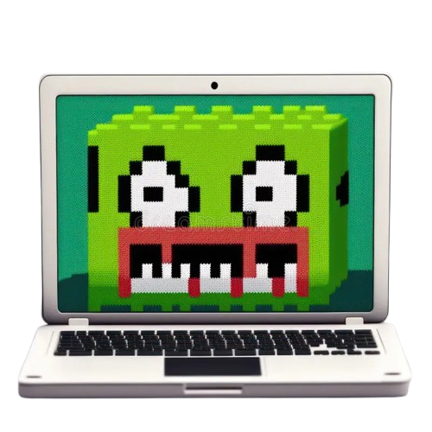
GOAL
The goal is to create a web-based interface for this cows and bulls game using python

Slide 10
TECHNOLOGY USED
Technology | Purpose
Python | Programming language
Django | Backend framework
HTML, CSS, Javascript | Frontend

Slide 11
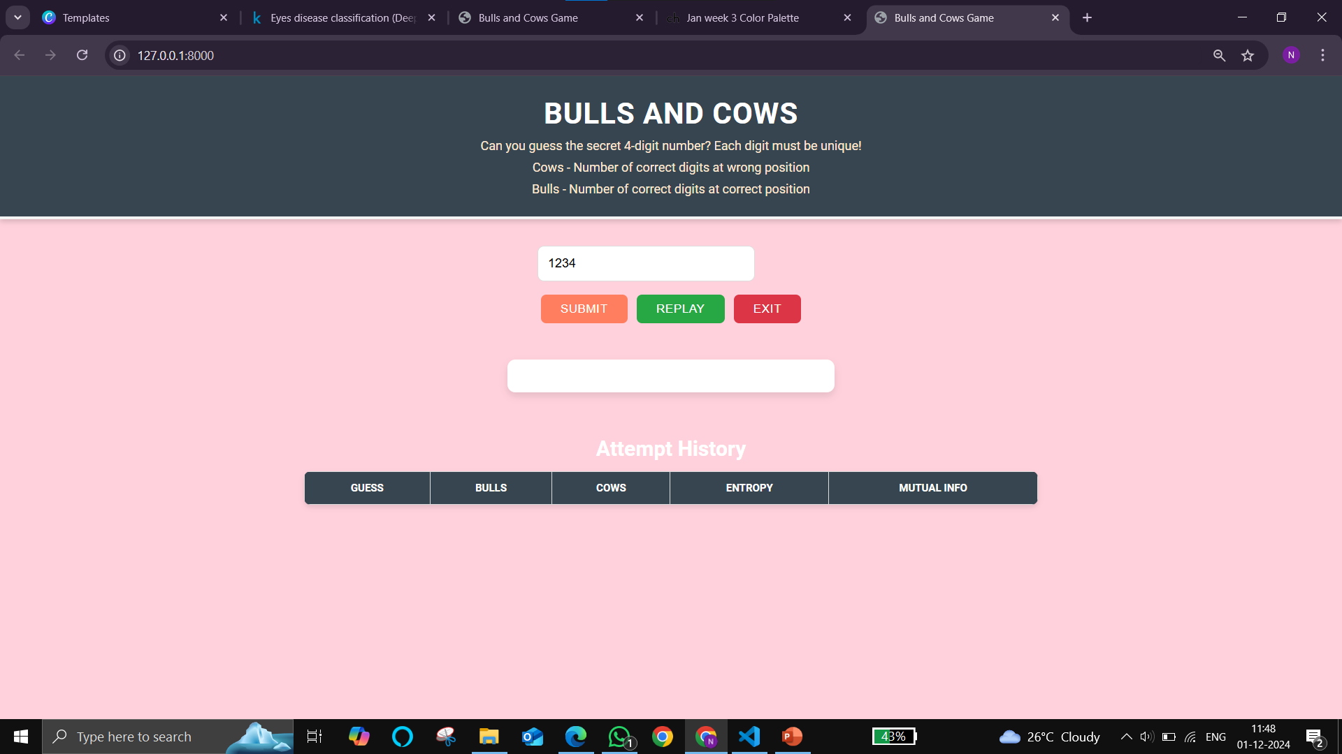
WEB INTERFACE

Slide 12
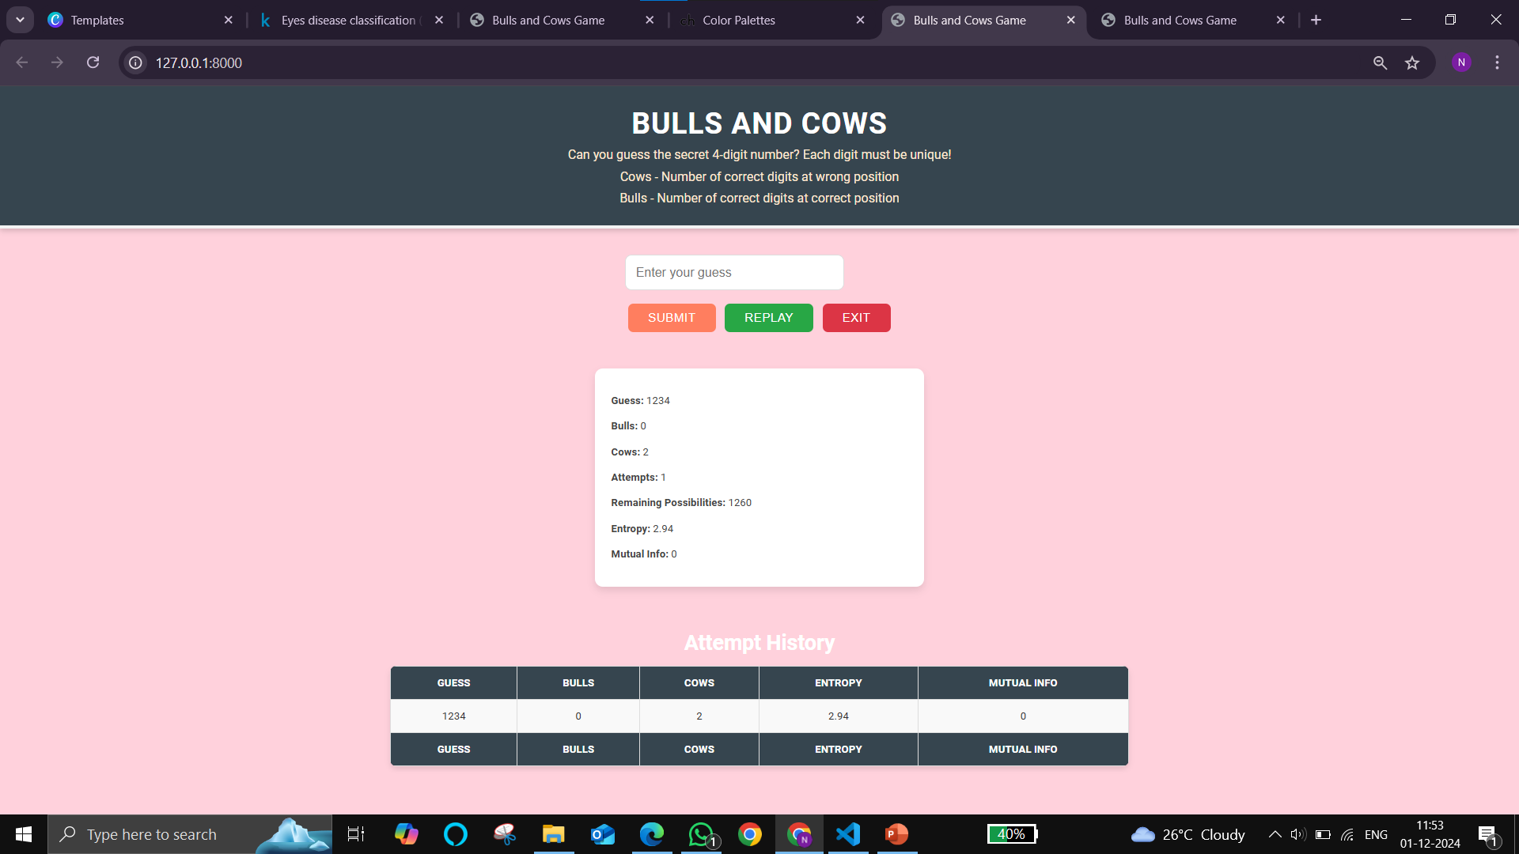

Slide 13
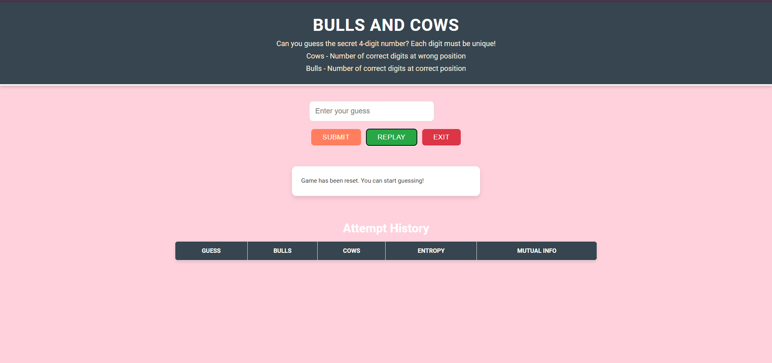

Slide 14
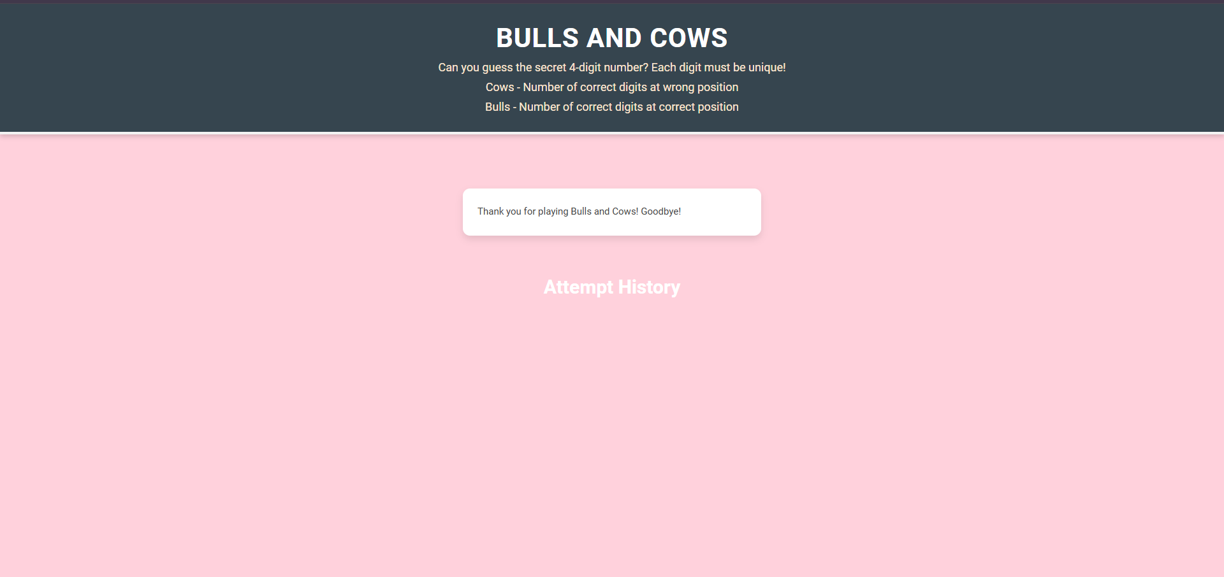

Slide 15
CONCLUSION
Entropy-based guessing in the Cows and Bulls game illustrates the power of leveraging information to reduce uncertainty efficiently. Ultimately, the approach showcases how systematic strategies can transform complex problems into manageable solutions, making entropy-based methods a cornerstone of efficient problem-solving.

Slide 16

FUTURE ENHANCEMENTS
Increase the difficulty level by using 5-digits
Enhancing the UI/UX with animations
Set the timer for the player to guess the number
Session management by adding pause and play options

Slide 17

THANK YOU!

